Slide 1
Tech lessons learned on the farm
Joe Houghes
Tim Smith
onlyfarms.fans

Slide 2
Agenda
1
2
3
4
Routine
Action
Rotate
Automate
5
Proper Tools

Slide 3
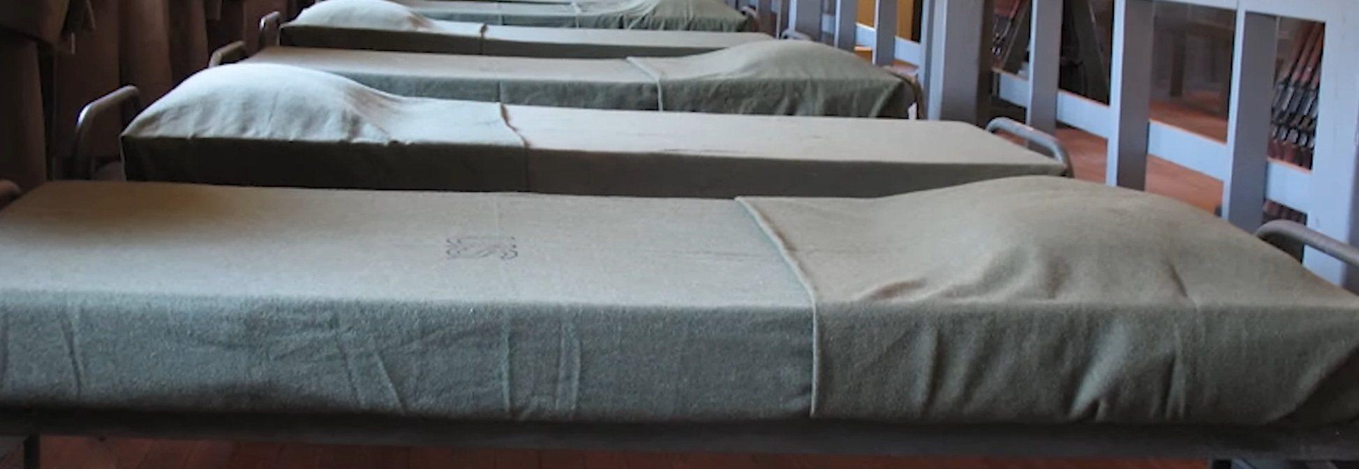
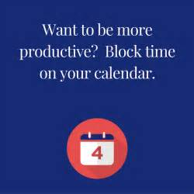
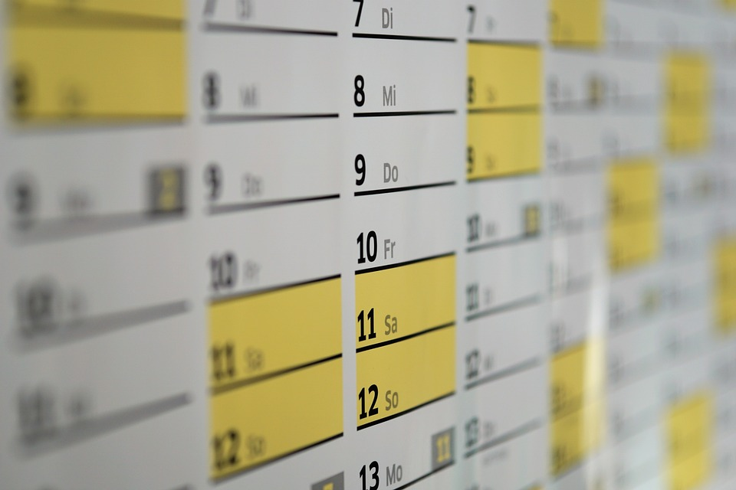
Routine
Make your bed!
Schedule around your most productive time.
Block your calendar.

Slide 4
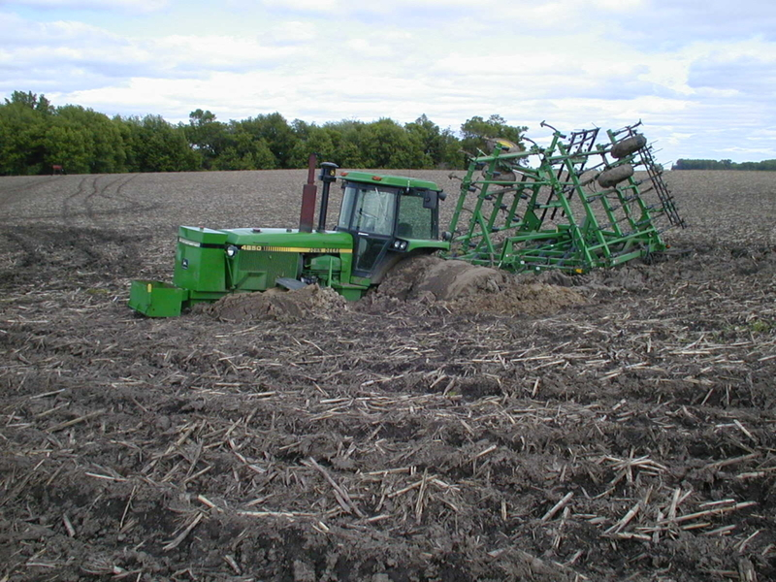

Slide 5
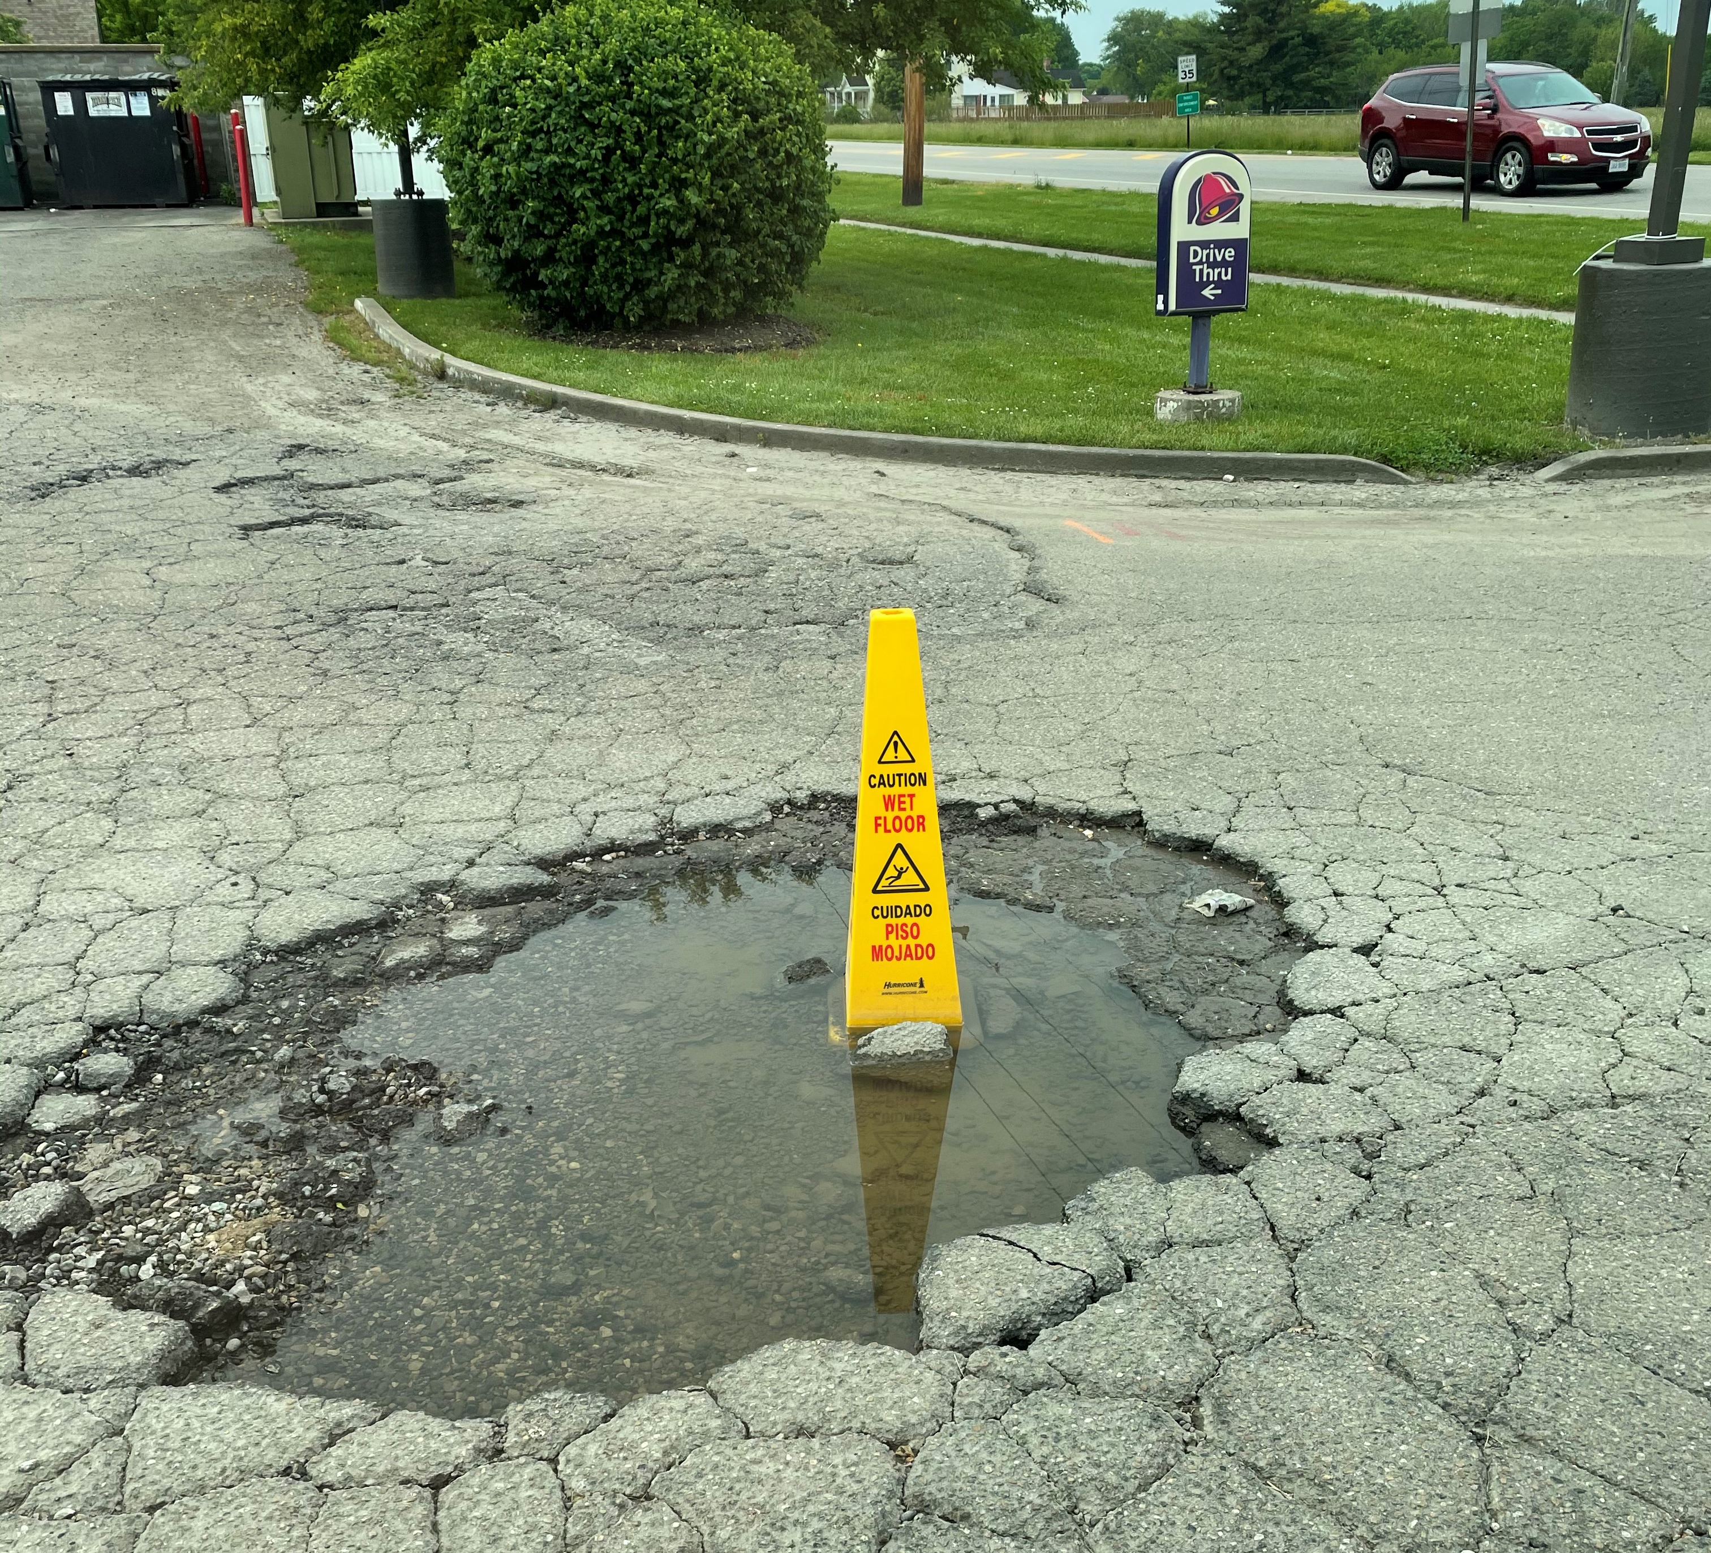
Something is better than nothing

Slide 6
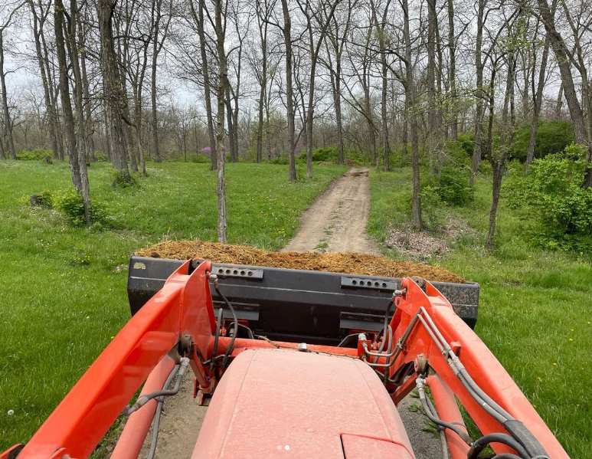
Sometimes you just have to deal with a steaming pile…

Slide 7
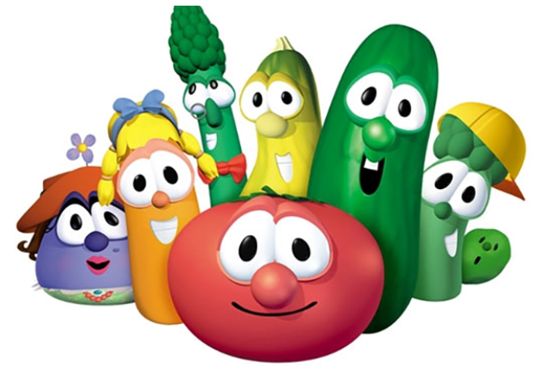
Rotate the crops

Slide 8


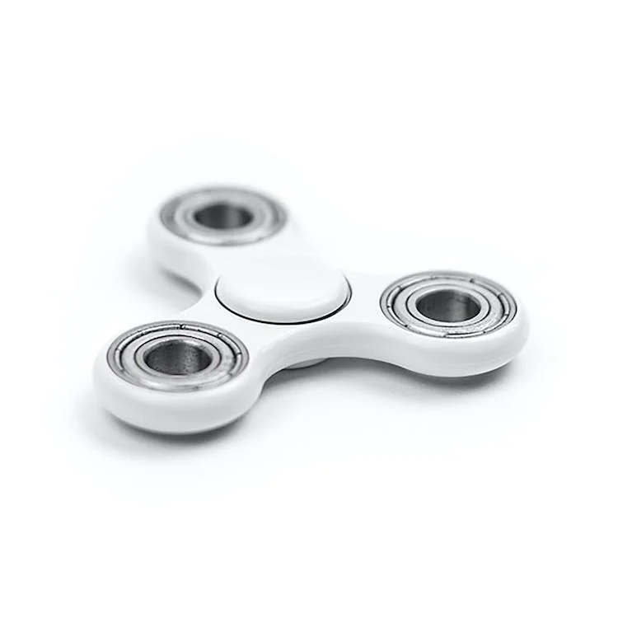
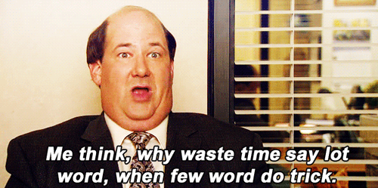
Rotate
Learn new tech
A bad season is ok
Learn soft skills

Slide 9
Automate
Simplify your daily/weekly/monthly routines
Not everything can be 100% automated

Slide 10
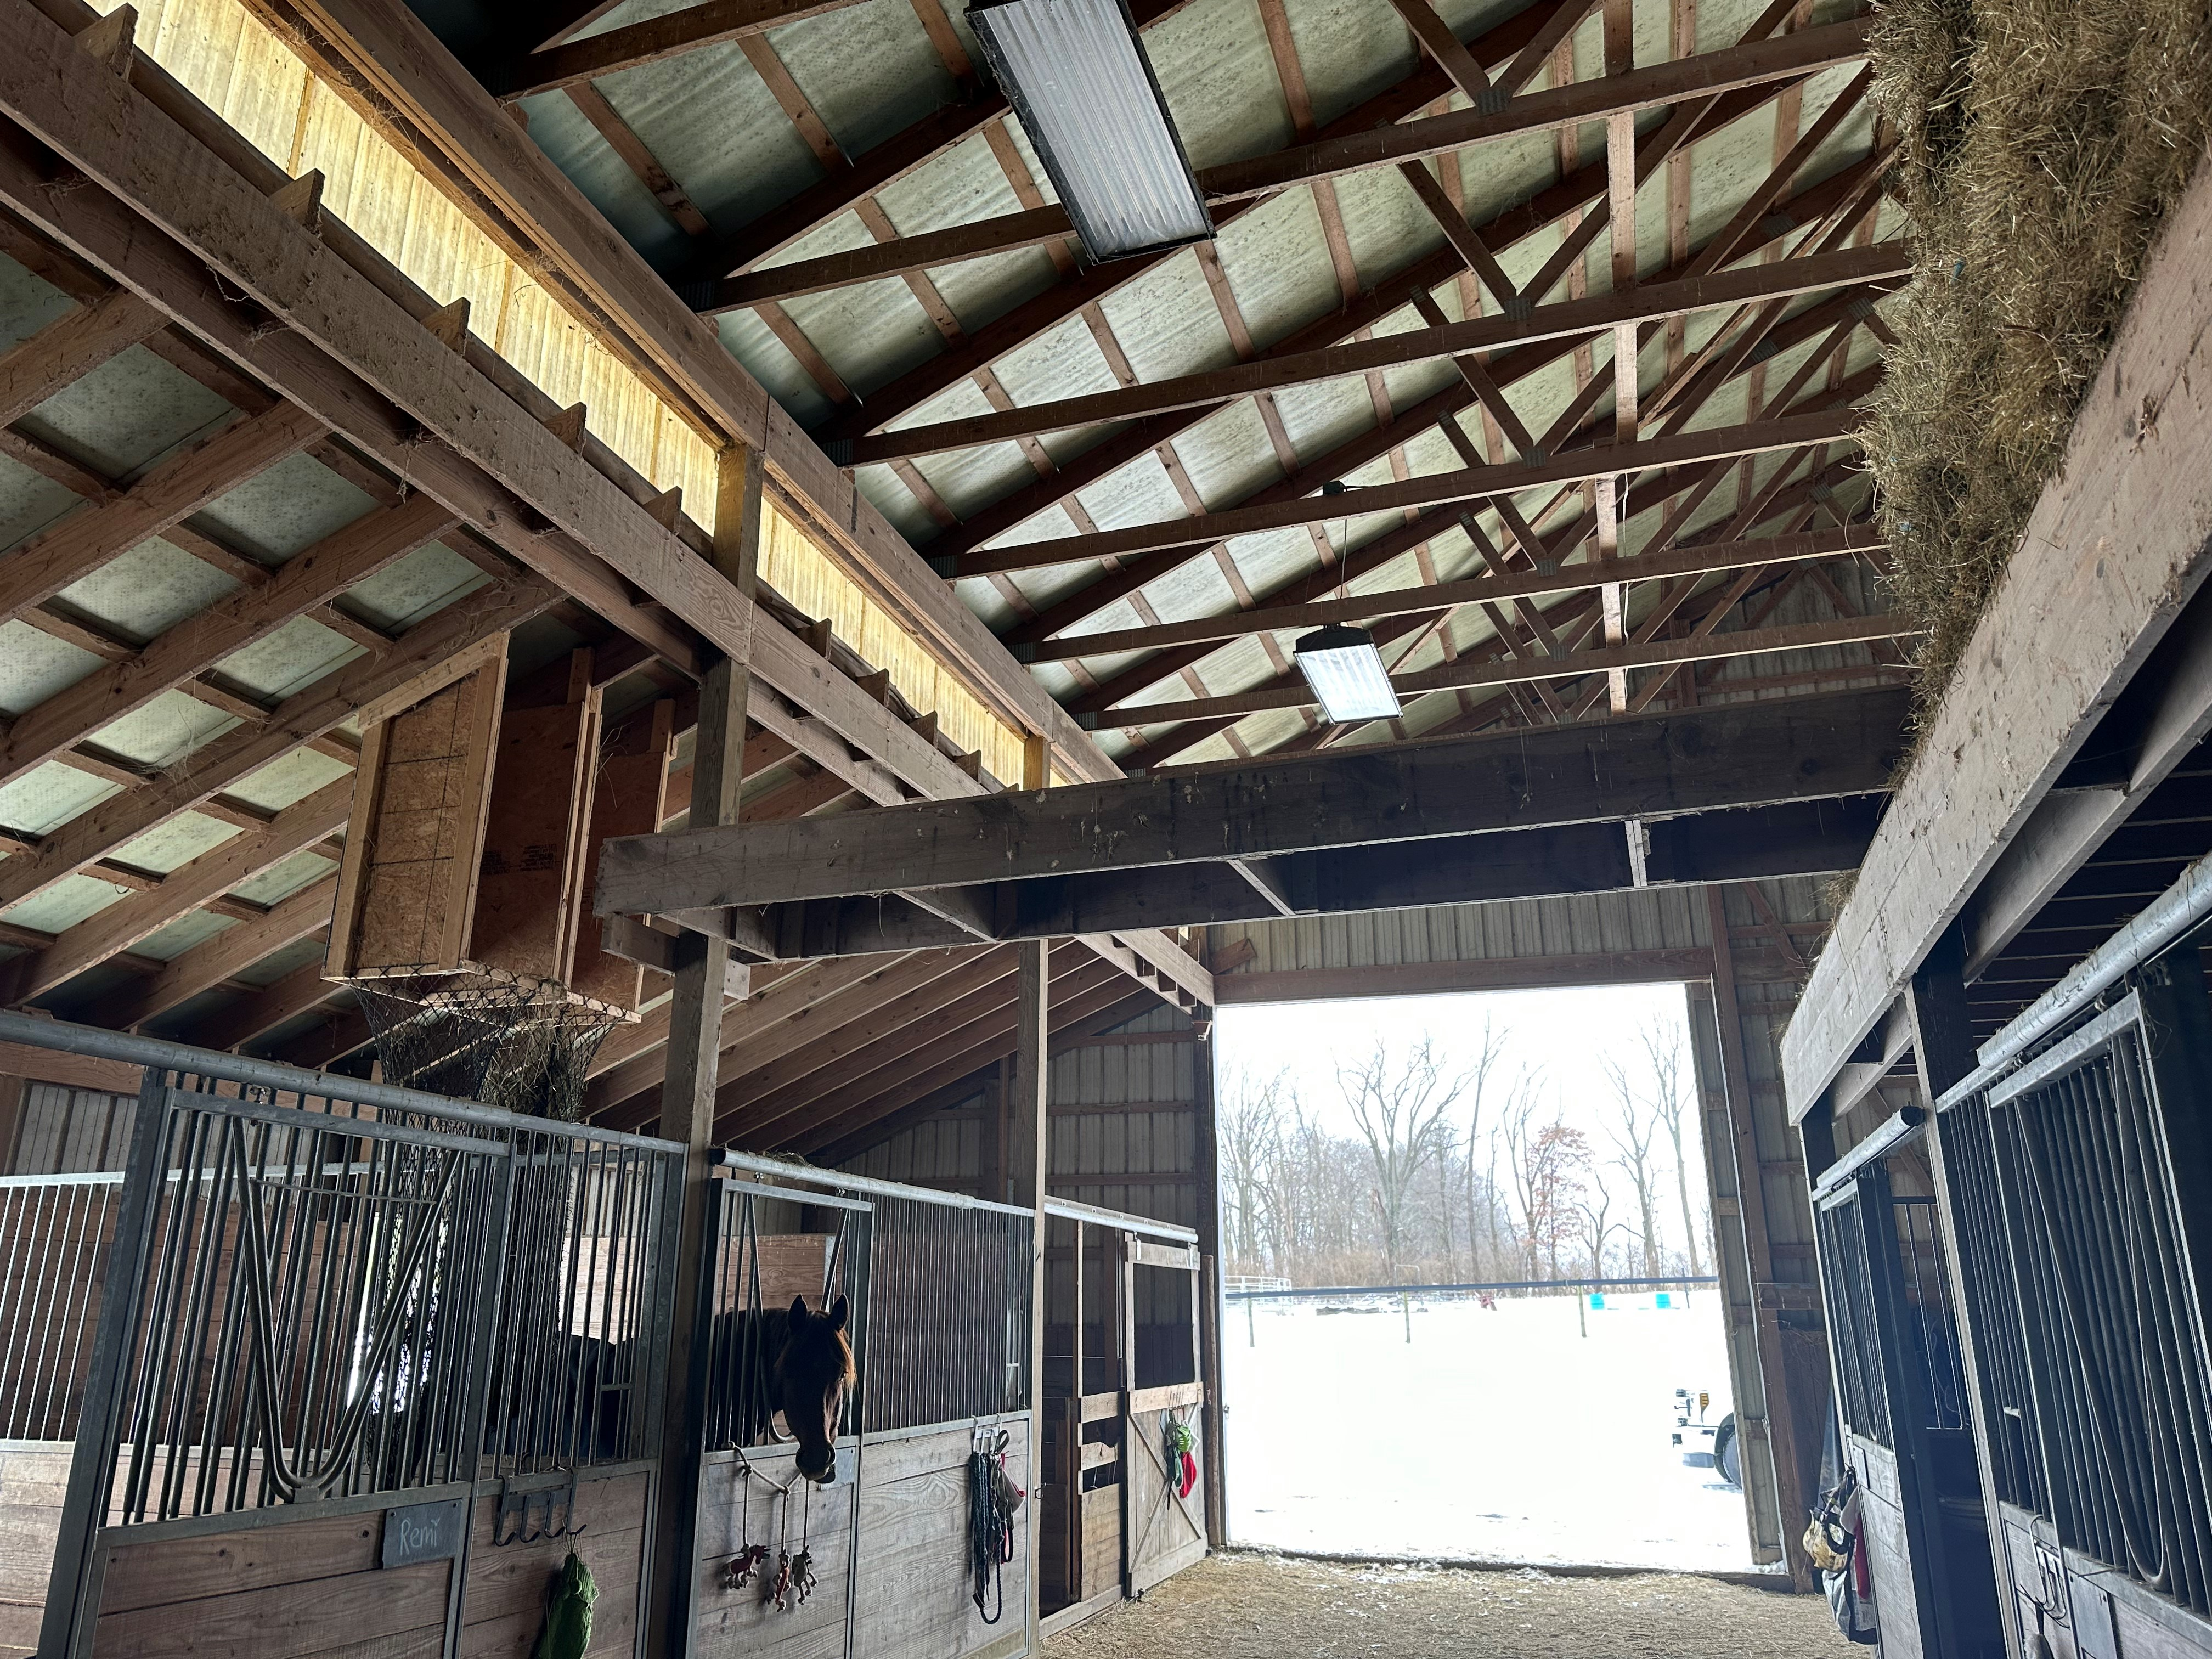
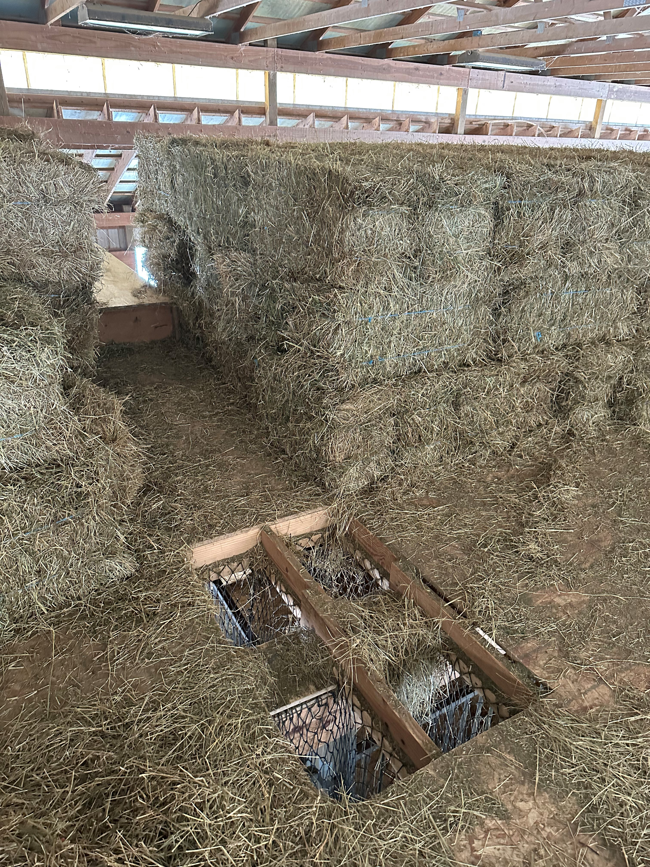
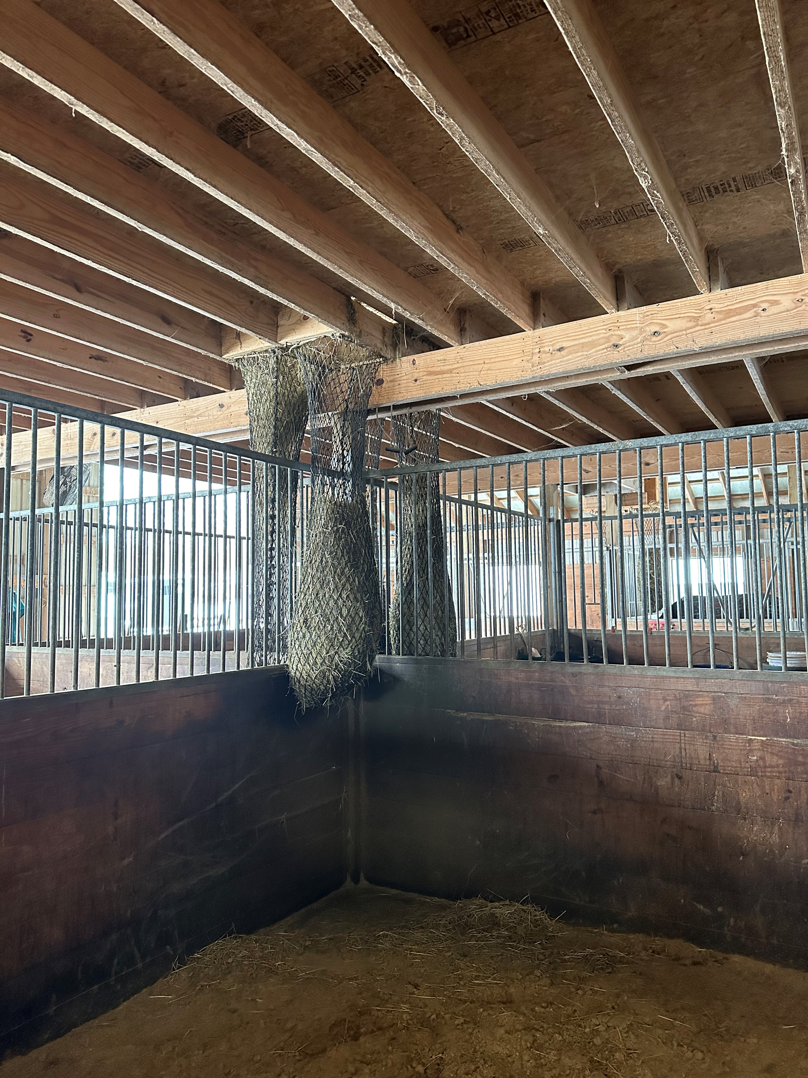
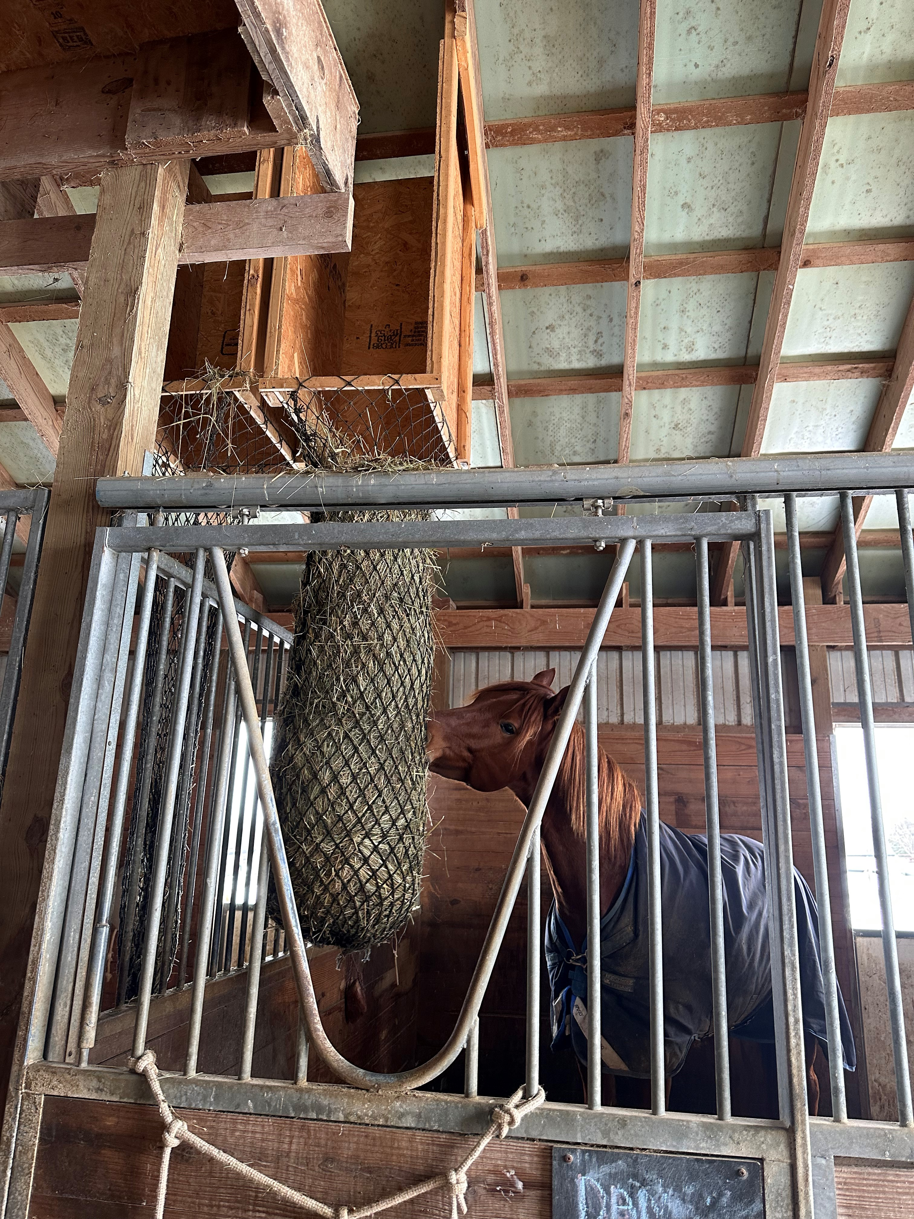

Slide 11
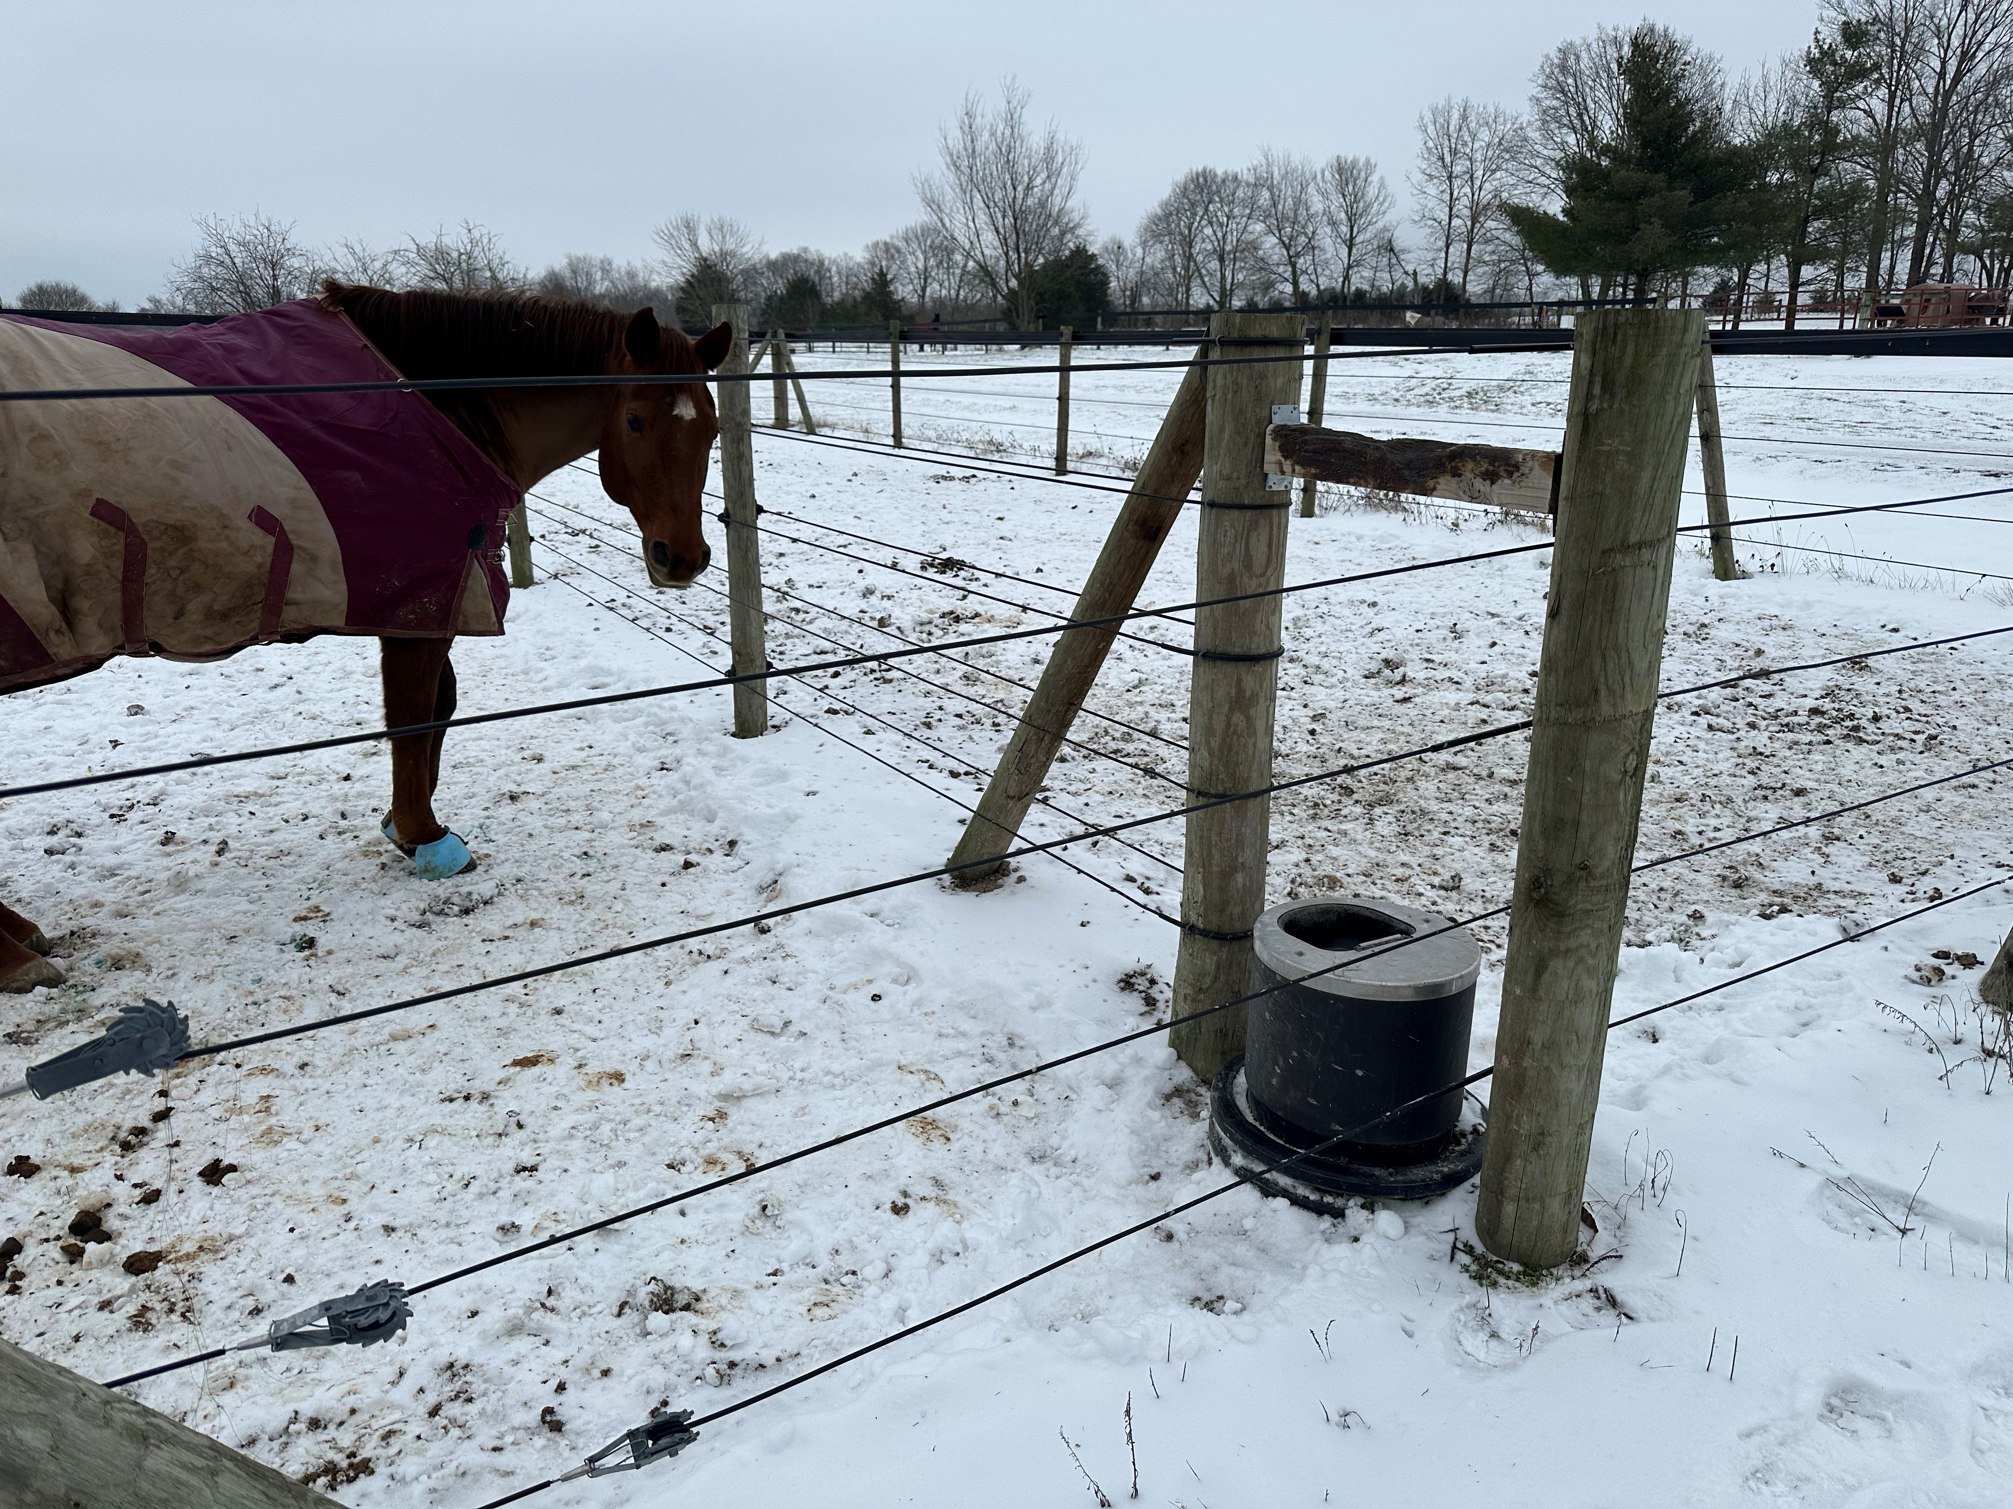
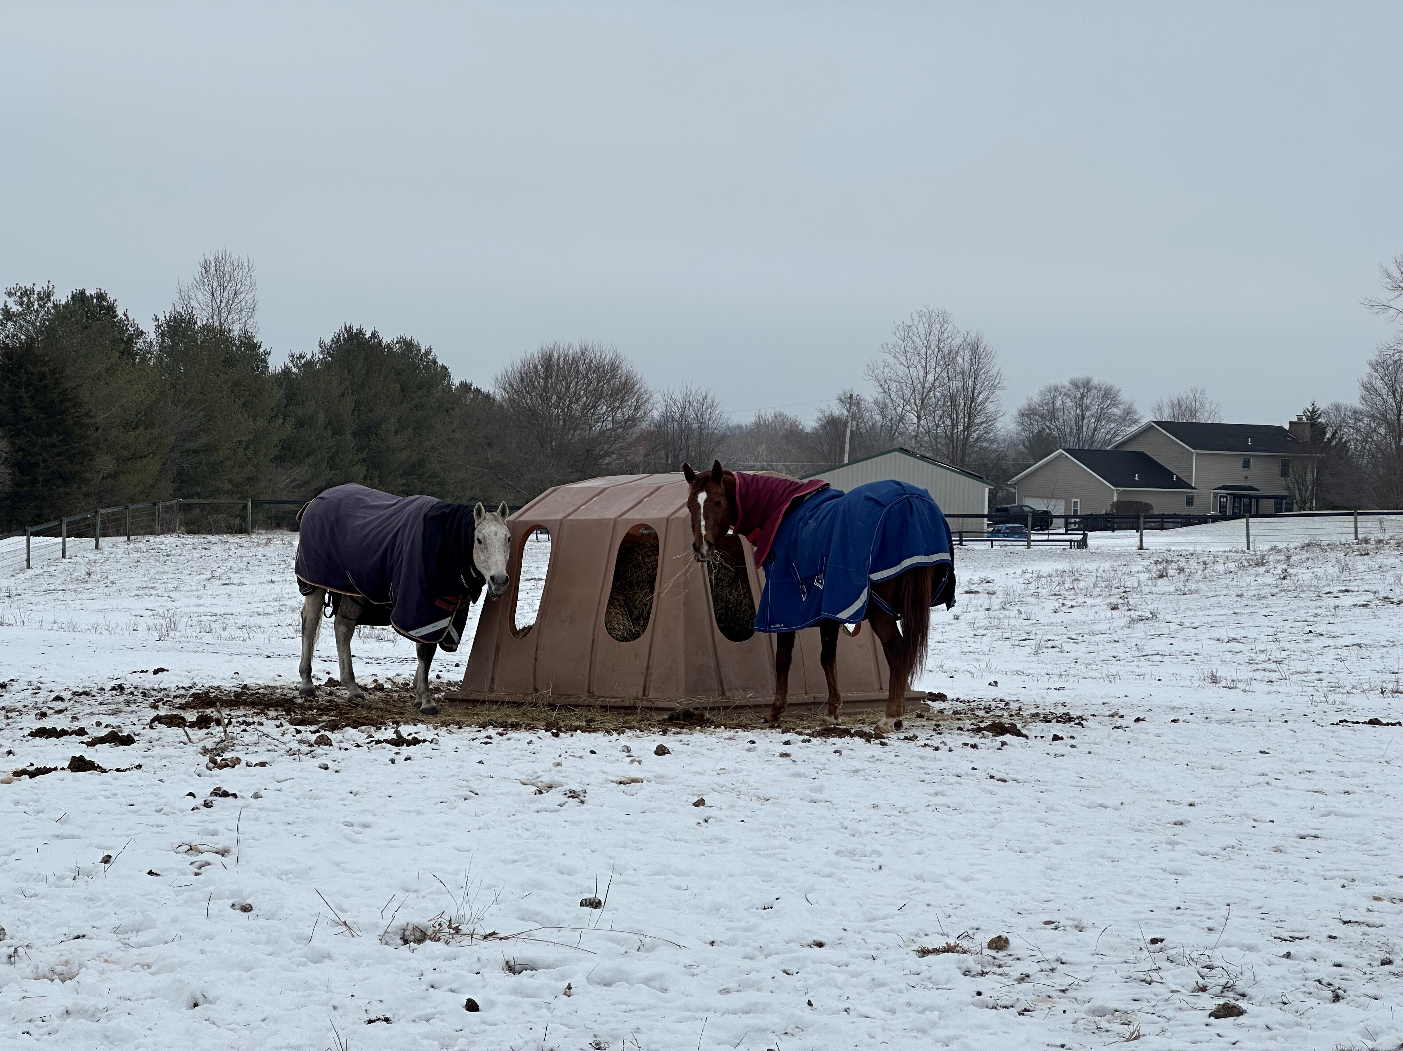
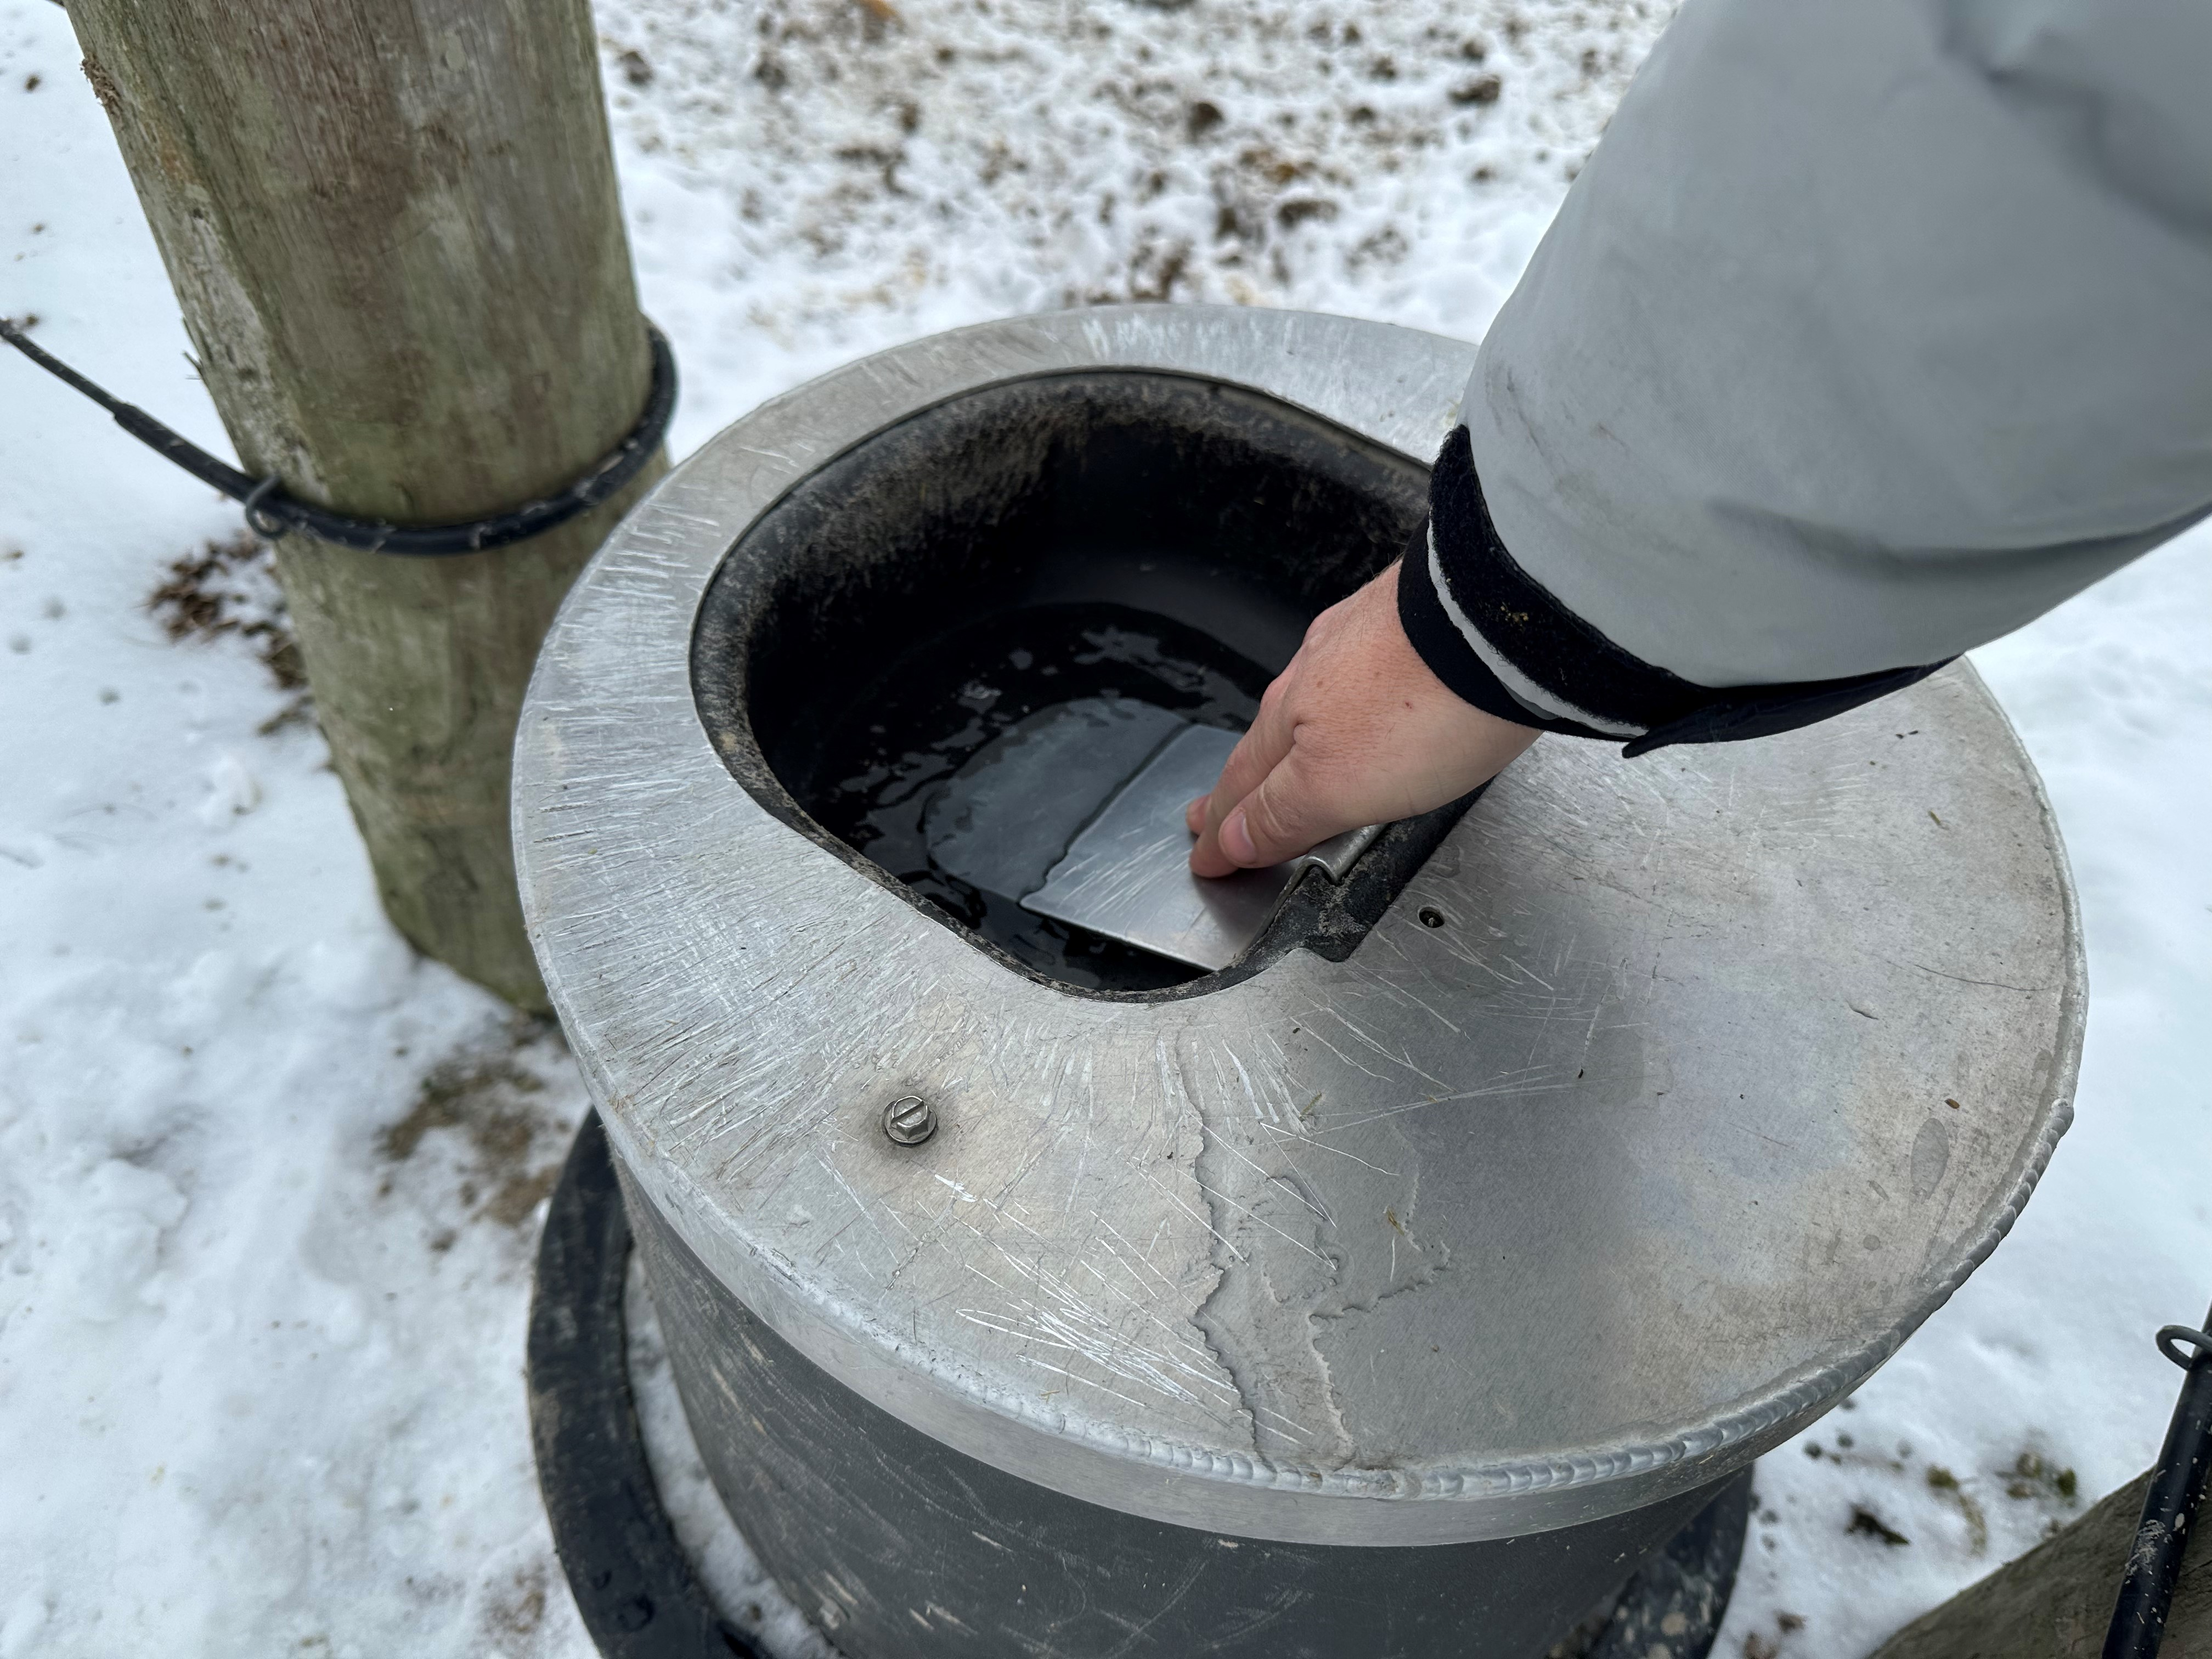

Slide 12
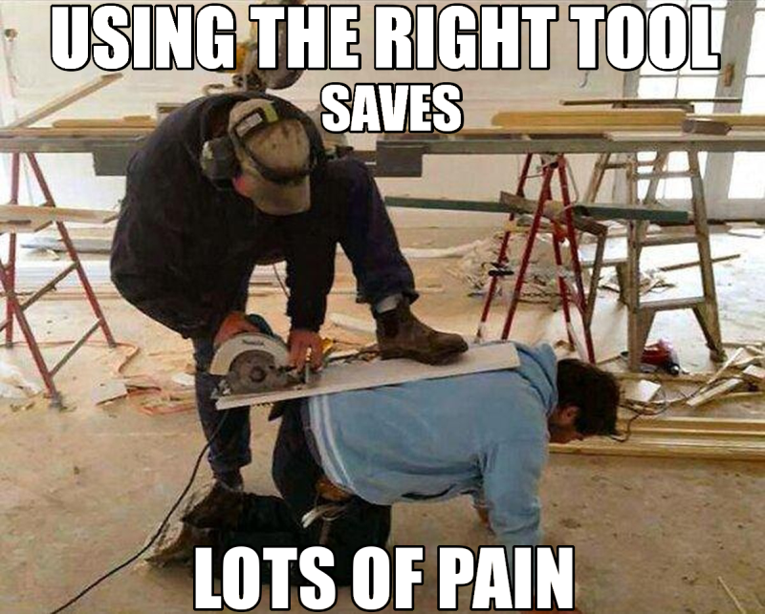

Slide 13

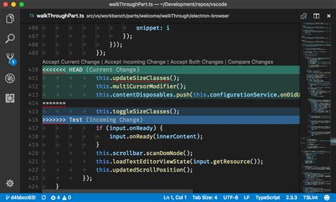



Right Tool for the Job
Security
Documentation
Backup
Monitoring

Slide 14










Books

